Slide 1
CASPR
(Controlled Area Security and Personal Recognition)
Matt Browne, Kofi Collins-Sibley, Devin Davies, Kurt Dentinger,
Ekin Develi, Kevin Wu
Advisor: Vincent Harris
Notes:
Good morning,
We are team CASPR,
[Introductions] and we’re here today to talk about CASPR,
A system for Controlled Area Security and Personal Recognition

Slide 2
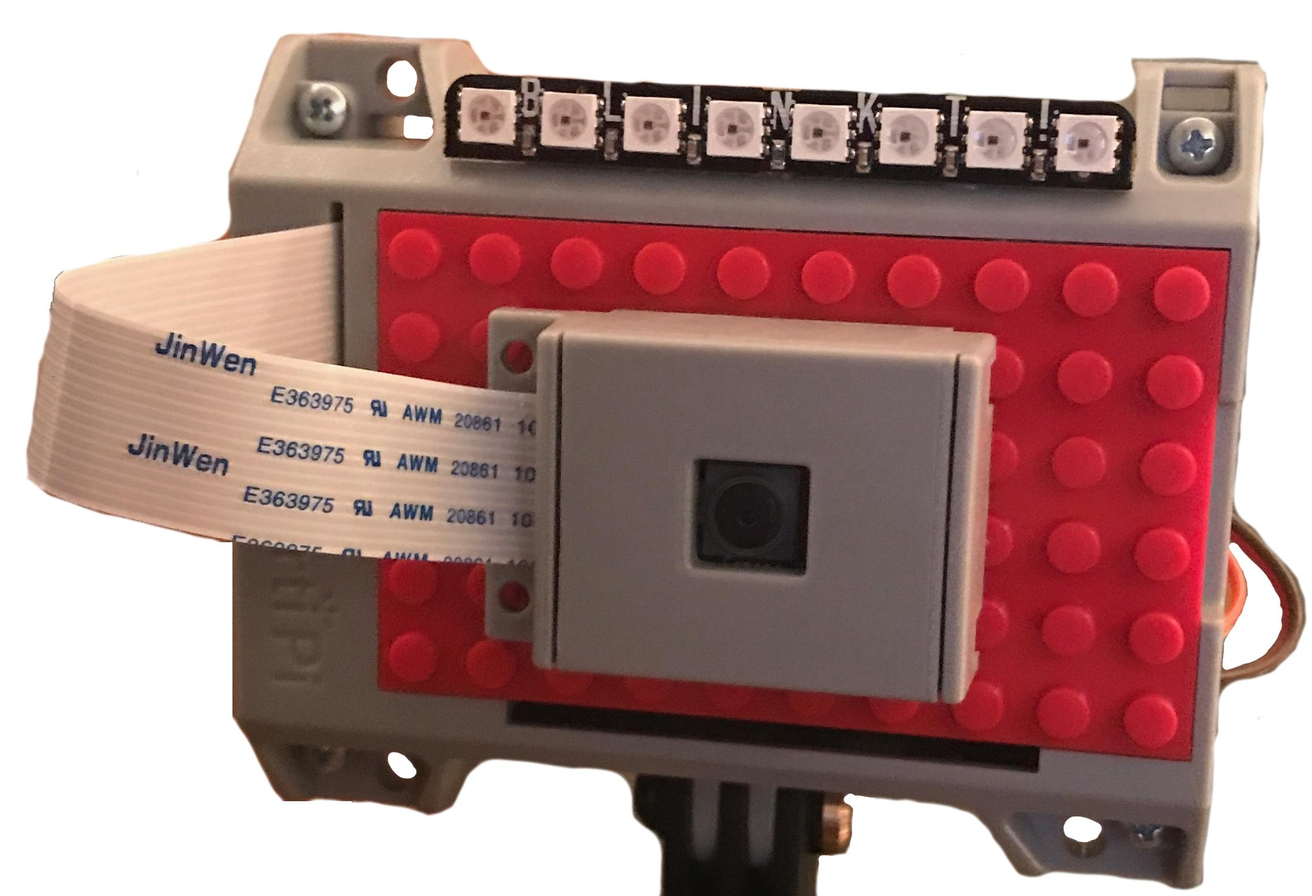
What?
What is CASPR?
A modular system for facial recognition based security in controlled access areas
Primary, CASPR can be used as an entry security system for locations like stadiums, concert venues, airports, and more
CASPR is designed to function along side existing security gateways
Notes:
[Kurt]
Overview of CASPR
Purpose:
Facial recognition applied to entry security in controlled access areas.
Use advancements in computer vision image processing to create a secure and reliable method of verifying individual’s identity and area access level

Slide 3

What?
What is CASPR?
CASPR consists of multiple low-cost, durable camera modules that can be stationed along side existing entry security check points
These modules are connected to a remote server application that does the heavy lifting
Notes:
[Ekin]
CASPR is designed to be flexible
Camera module design can vary depending on the situation
Cameras interact with the server application via a standard web API
The server application doesn’t care how the camera is configured as long as it supplies appropriately formatted image data

Slide 4
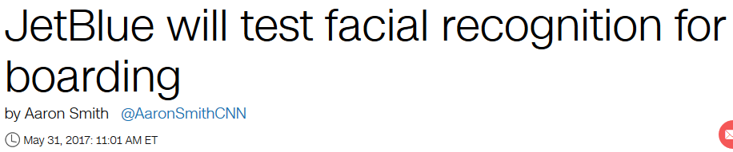

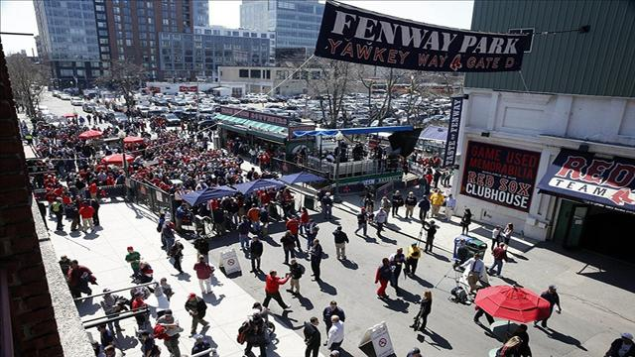

Why?
Why is CASPR important?
Security in crowded high throughput locations
Stadiums
Concert venues
Airports
Attendance data and analytics
Demand for analysis of crowd characteristics
Notes:
[Devin] Why is CASPR important?
Computer vision has the potential to revolutionize how we deal with security, you can see this with Apple’s new FaceID as a replacement for TouchID.
Use Case: think about venues like Fenway Park or TD Garden where you have a high throughput of people going into a location in a short period of time. And think about when an individual is banned for one of these locations. How can we be sure that that person is never allowed back in? Especially if they buy a ticket with cash
Analytics is another angle to look at. Imagine a sports venue going into sponsorship talks with a brand where the venue can say, look we have X number of people walking through our gates everyday with your brand on

Slide 5
Why?
Why is CASPR important?
CASPR offers a fast and customizable system to solve these security issues
CASPR offers extendability that can include any number of post processing analysis features
Notes:
[Devin] Why is CASPR important?
With CASPR we wanted to create a system that is primarily fast enough to handle high throughput situations and be customizable and flexible enough to be used in a multitude of use cases.
CASPR is designed to extendable so that individual venues and situations can add features
More on this later in the presentation

Slide 6
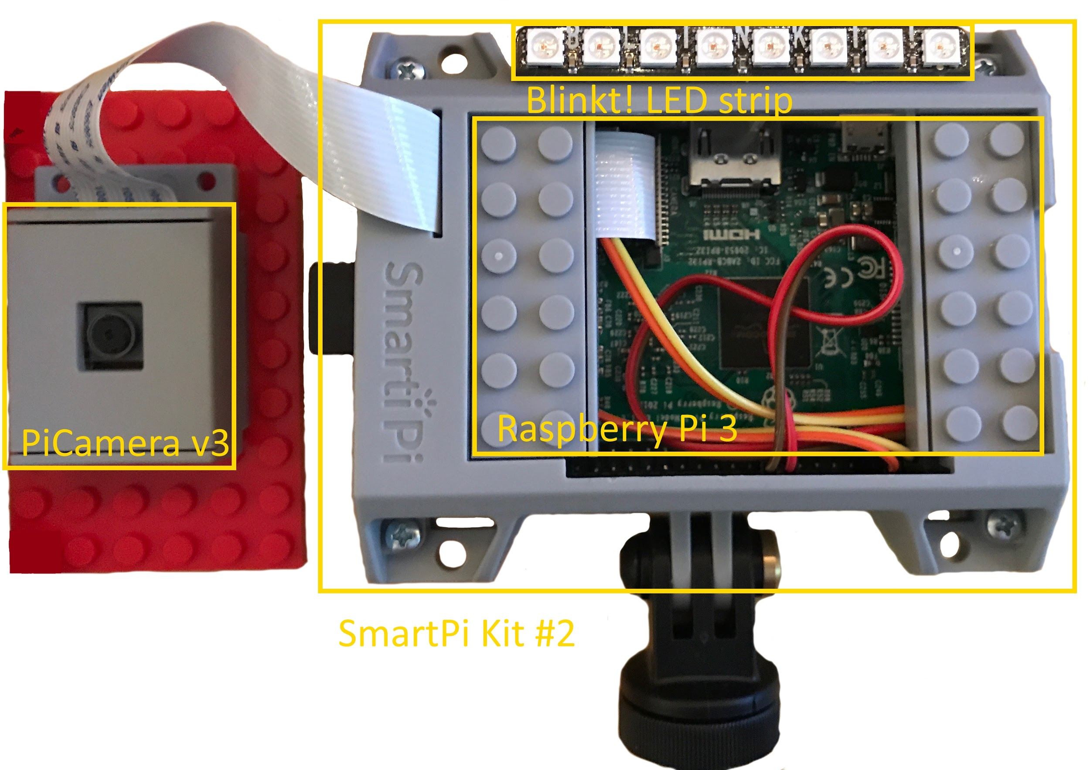
How?
Camera module
How did we build CASPR?
Notes:
[Kevin]
The Camera module is designed to be cheap and durable.
The Raspberry Pi ARM Processor is the core of the camera module and connects to the server application via built in WiFi.
The Blinkt LED strip handles user interaction through various color codes.
Cost effectiveness

Slide 7
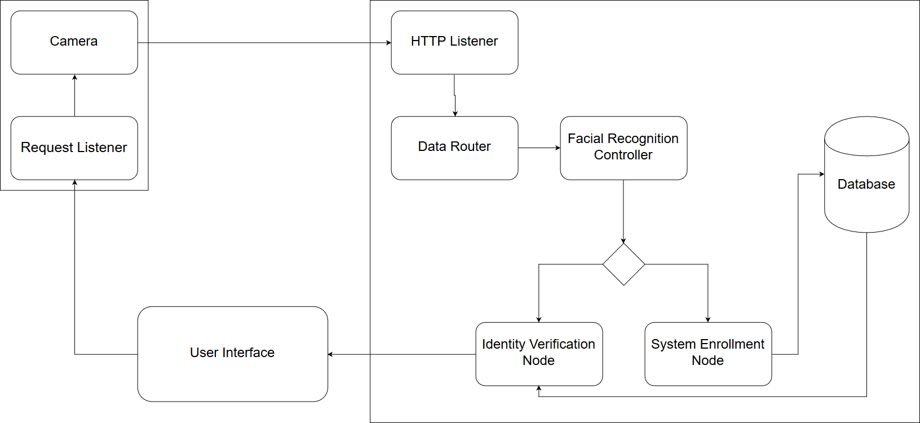
How?
Server Application
Notes:
[Kofi]
The server application is divided into distinct modulars that can be customized to suit the situation at hand
This is one of the focal points of the application and is also how CASPR keeps processing time as fast as possible
In larger uses, you can have multiple copies of the server application running.
Rather than having 100 cameras connecting to one controller, have 20 controllers each with 5 cameras
All the controllers will talk to the same database

Slide 8
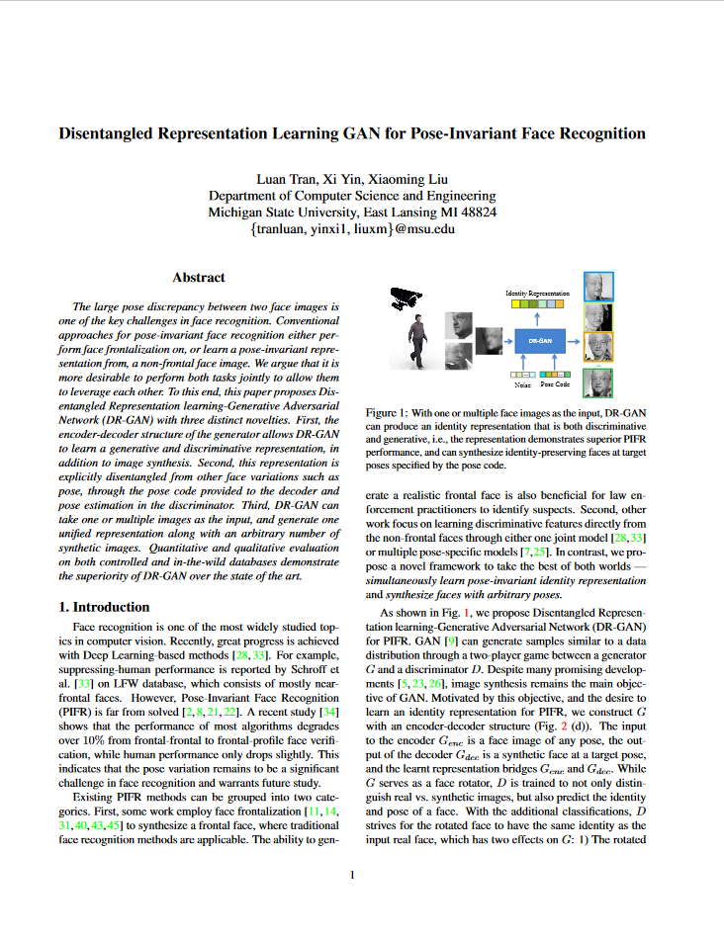
How?
Pose Invariant Facial Recognition
Disentangled Representation Generative Adversarial Network.
Three Models working together
Generator Encoder
Generator Decoder
Discriminator
Notes:
[Matt talks about pose invariant recognition]
We identified the Pose Invariant facial recognition method as one of our top 5 risks when starting CASPR and unfortunately while we are very close to having pose invariant recognition running in CASPR, we did not complete this in time for today’s presentation.
Knowing that risk we developed a backup plan along side… [to which we will shortly be getting]

Slide 9
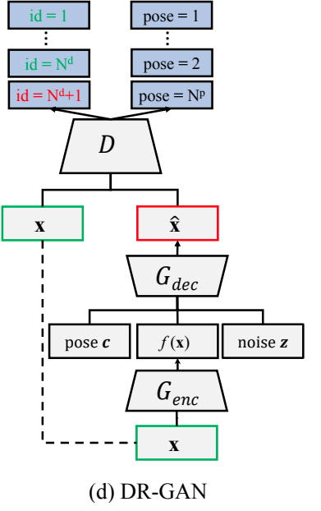
Challenges with DRGAN
Gathering Training Data
Choosing best Optimizers and Hyper-parameters
Time consuming training process
Notes:
[Matt?]

Slide 10

Actually How?
Plan B
Face Recognition library
Industry leading open source facial recognition library using the MIT license
“Built using dlib's state-of-the-art face recognition built with deep learning. The model has an accuracy of 99.38% on the Labeled Faces in the Wild benchmark.”
Adam Geitgey
Notes:
[Kofi]
As a backup plan for the pose invariant facial recognition method, we turned to the Face Recognition library available on GitHub under the MIT license.
Face Recognition boasts a 99.38% accuracy score on the Labeled Faces in the Wild benchmark, containing 13,000 faces, and is a good alternative while we complete work on the pose invariant recognition method

Slide 11

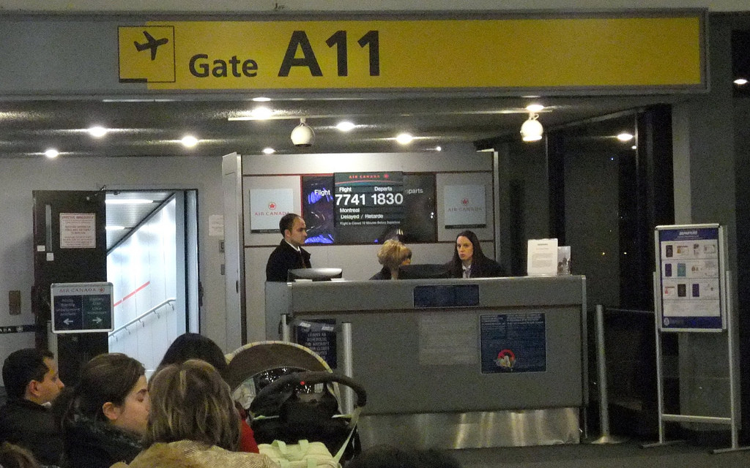
Extendability
How can CASPR be used in the real world?
Employee Check-in and Check-out
Brand identification
Paperless airline boarding
Connection to Law enforcement database(s)
Notes:
[Kurt] Here are some some use cases in addition to security we’ve identified that CASPR can work with.

Slide 12
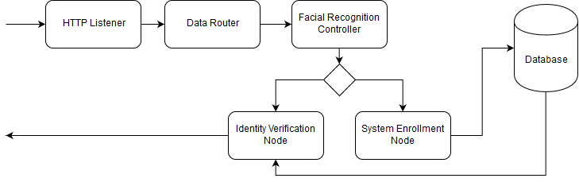
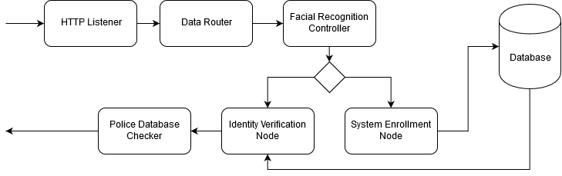
Extendability
Adding Features
Notes:
[Kevin]
Adding new features is as simple as adding a new node to the pipeline
How about checking against a BPD database of outstanding warrants?

Slide 13
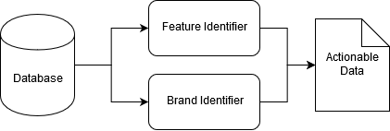
Extendability
Post Processing
Notes:
[Ekin]
CASPR also creates actionable data that can be used for crowd analytics
What if you want to add some post processing to the data collected by CASPR?
If there’s a large proportion of your audience wearing Nike gear maybe you should consider approaching Nike for a sponsorship deal
Or if your audience skews to a certain demographic maybe change up your marketing campaign

Slide 14
Demo

Slide 15
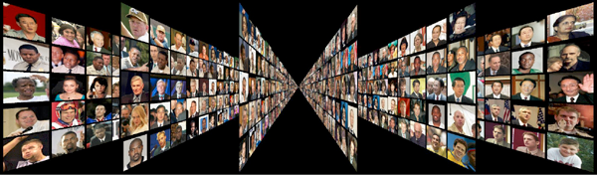
System Effectiveness
CASPR was tested using a subset of the Labeled Faces in the Wild (LFW) benchmark as well as the six members of team CASPR and our advisor
CASPR has proven effective with eyewear
Currently CASPR is limited in its ability to detect spoofing
This will be improved with integration of Pose-Invariant facial recognition
Notes:
[This is where we’ll do our on stage demo]
The Labeled Faces in the Wild (LFW) is a facial recognition benchmark created at UMASS Amherst and contains over 13,000 images in total.
We tested CASPR using a subset of about 1,000 images.
These images were loaded into CASPR’s database along with our team members faces
As you can see in the demo, CASPR is able to accurately pick out our faces amongst the 1,000+ faces it has enrolled

Slide 16
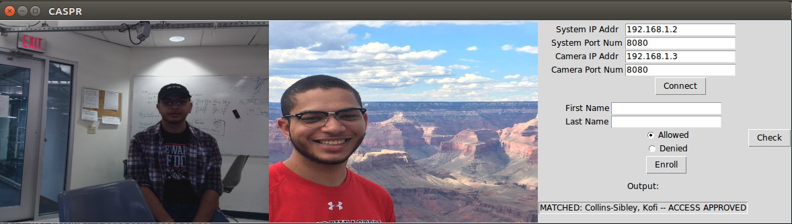
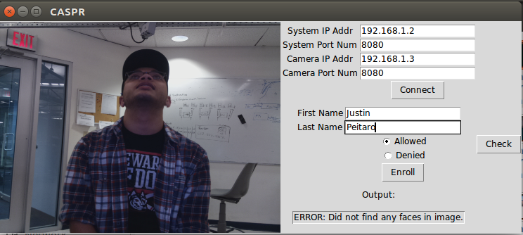
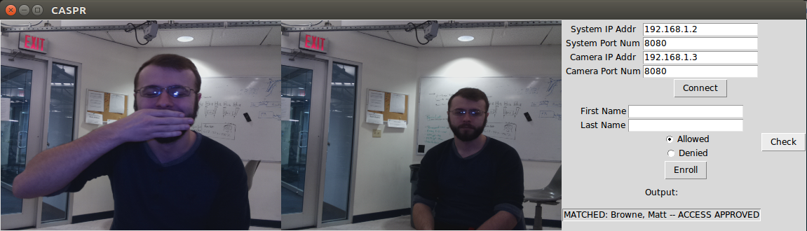
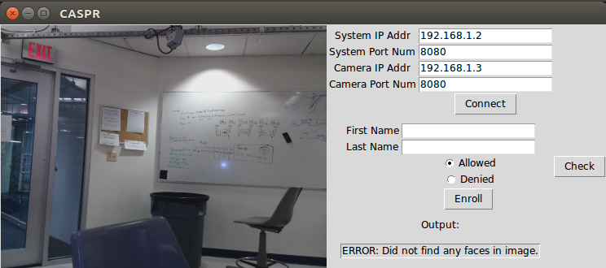
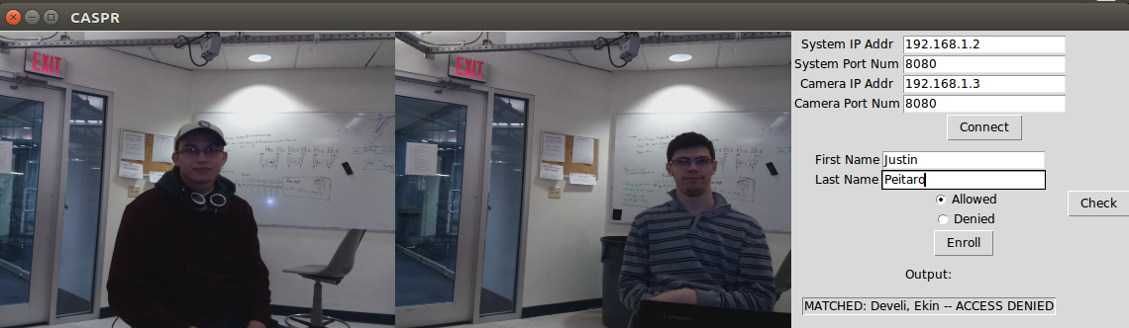
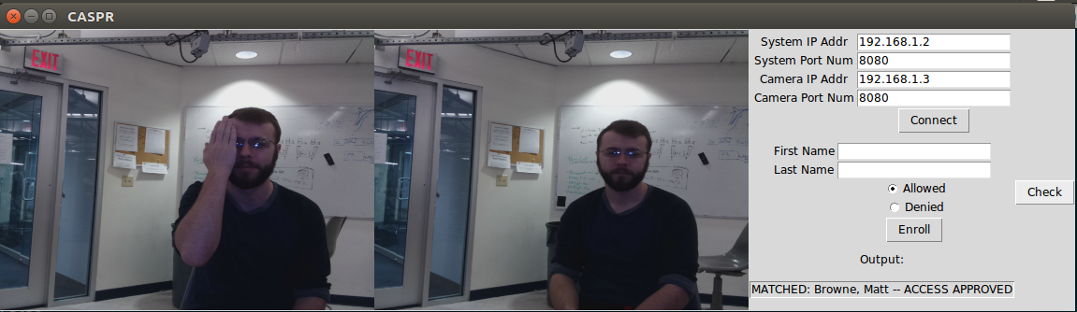
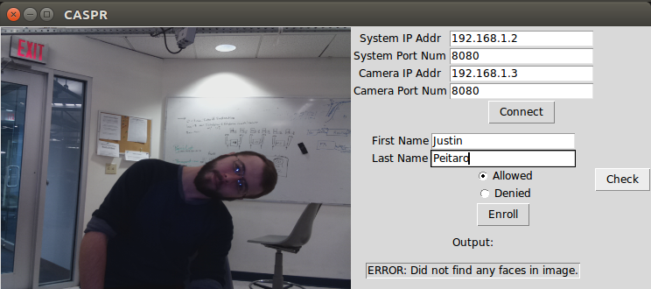
Results

Slide 17
References
Disentangled Representation Learning GAN for Pose-Invariant Face Recognition
Luan Tran, Xi Yin, Xiaoming Liu Department of Computer Science and Engineering Michigan State University, East Lansing MI 48824 { tranluan, yinxi1, liuxm }@msu.edu
http://cvlab.cse.msu.edu/pdfs/Tran_Yin_Liu_CVPR2017.pdf
Face Recognition library
https://github.com/ageitgey/face_recognition
Labeled Faces in the Wild
http://vis-www.cs.umass.edu/lfw/

Slide 18
Questions
Notes:
Feel free to come by our board for a personal demo of CASPR in action

